Slide 1
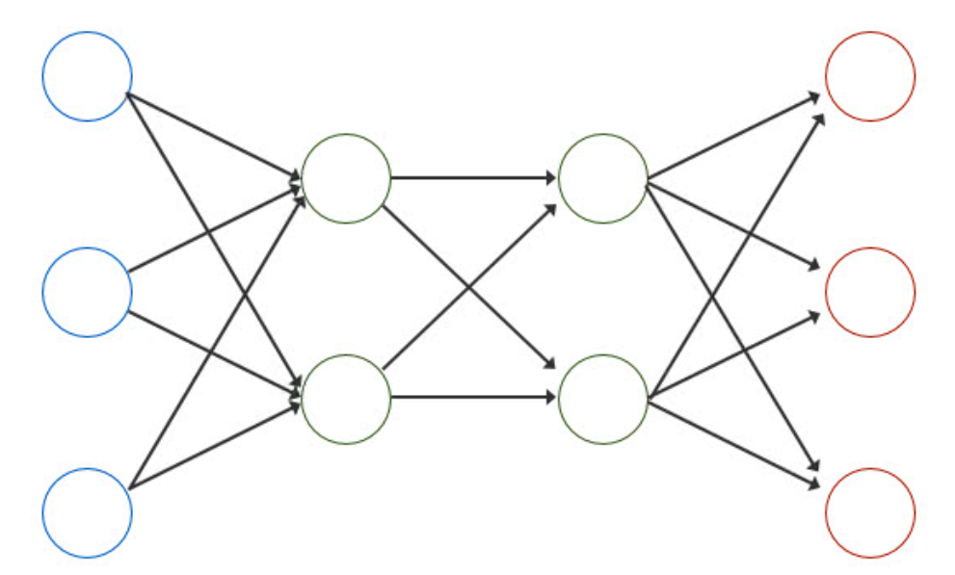
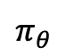
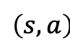
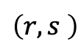
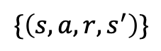
Weekly Report
Read a paper
[1]: T. Matsushima, H. Furuta, Y. Matsuo, O. Nachum and S. S. Gu. “Deployment-Efficient Reinforcement Learning via Model-Based Offline Optimization”, arXiv preprint arXiv: 2006.03647v2, 2020.
[1] is a hybrid RL of offline and online
$π_{θ}$
$$\left(s,a\right)$$
K times
Data sampling
(K = 1 for
offline RL)
agent
T times
Policy update
(T = 1 for
online RL)
env
$$\left(r,s \right)$$
$$\{\left(s,a,r,s^{′}\right)\}$$
model

Slide 2
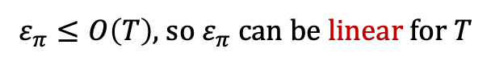
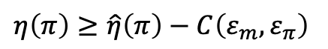
Weekly Report
Model estimation is suffered from distributional shift
How is unknown state? How is unknown input?
Policy update enhances input distributional shift
Trade-off between performance and policy update (parameter T) ?
[1] proved it:
$$η\left(π\right)≥\hat{η}\left(π\right)−C\left(ε_{m},ε_{π}\right)$$
$$C\left(ε_{m},ε_{π}\right)=O\left(ε_{π}\right),{ε_{π}=D}_{TV}(π_{sample}, π)$$
It gets harder to guarantee performance as T gets larger
$ε_{π}≤O\left(T\right),$so $ε_{π}$ can be linear for $T$

Slide 3
Weekly Report
Read papers to see approaches with control theory
N. M. Yazdani, R. K. Moghaddam, B. Kiumarsi and H. Modares, "A Safety-Certified Policy Iteration Algorithm for Control of Constrained Nonlinear Systems," in IEEE Control Systems Letters, vol. 4, no. 3, pp. 686-691, 2020.
M. Hertneck, J. Köhler, S. Trimpe and F. Allgöwer, "Learning an Approximate Model Predictive Controller With Guarantees," in IEEE Control Systems Letters, vol. 2, no. 3, pp. 543-548, 2018.

